Slide 1
Introduction to Data Science
Data Science
Dr. Irfan Younas
Lecture 1 – Spring 2021

Slide 2
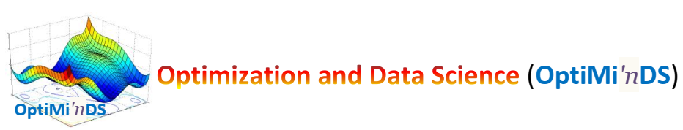
Introduction to Optimization
Research Themes: Evolutionary Computation, Swarm Intelligence, Evolutionary Deep Learning, Multi/Many-objective Optimization, Artificial Intelligence, Data Science, Machine Learning, Natural Language Processing and Information Retrieval
Past and Ongoing Projects (http://lhr.nu.edu.pk/fsc/research/)
Designing novel Socio-inspired Optimization Algorithms for Global Optimization
Developing Transfer Learning Based Classifier System for Image Classification
Evolving Deep Neural Networks using Evolutionary Computation
Automatic Cardiac Segmentation using Metaheuristics and Active Contours
Large scale optimization of Assignment, Planning and Scheduling Problems
Distributed Large Scale Many Objective Optimization
Multi and Many Objective Optimization Algorithms
Many Objective Optimization for IoT
Learning Regular Expressions using Learning Classifier Systems
Solving Large-scale Optimization Problems using Evolutionary Computation and Machine Learning
Solving Classification and Learning Problems using Evolutionary Machine Learning
Predicting Future News Events and Crimes using Data Science

Slide 3
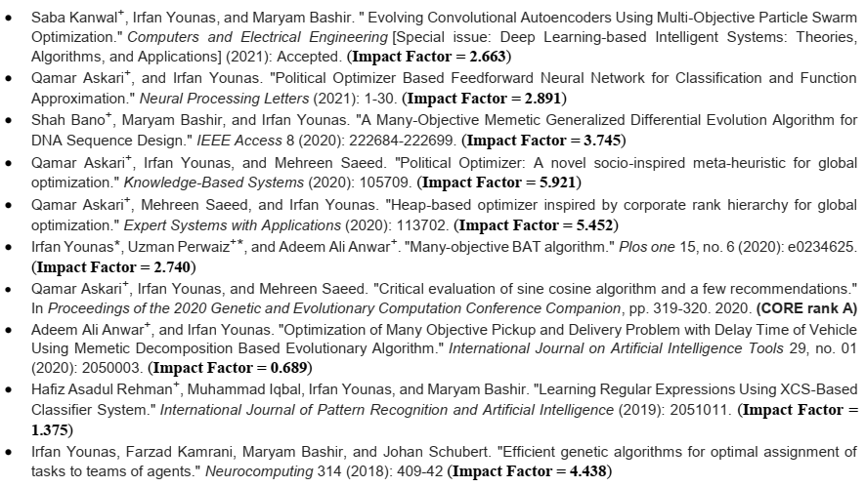
Introduction to Optimization
Recent Publications

Slide 4
Introduction to Optimization
Top Journals
  IEEE Transactions on Evolutionary Computation
  Evolutionary Computation
  IEEE Computational Intelligence Magazine
  Knowledge-based Systems
  Expert Systems with Applications
  Applied Soft Computing
  Swarm & Evolutionary Computation
  Neurocomputing
  there are other related journals also (like soft computing, computational intelligence, European journal of operational research, Computers and Operations Research etc.)
Top conferences
  Genetic and Evolutionary Computation Conference (GECCO)
  IEEE Congress on Evolutionary Computation

Slide 5
Introduction to Optimization
Outline
What?
Why?
How?
Data Science: Steven Skiena

Slide 6
Introduction to Optimization
What is Data Science?
Like any emerging field, it isn’t yet well defined, but incorporates elements of:
Data Wrangling
Exploratory Data Analysis and Visualization
Machine Learning and Statistics
High-Performance Computing technologies for dealing with scale.
Data Science: Steven Skiena

Slide 7
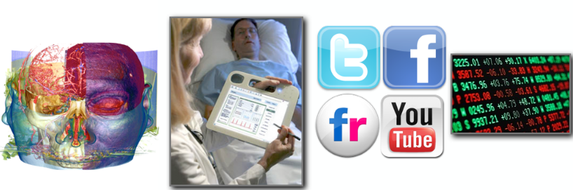
Introduction to Optimization
What is Data Science?
To gain insights into data through computation, statistics, and visualization
Data Science: Hanspeter Pfister

Slide 8
What is Data Science?
New technology makes it possible to capture vast amounts of logging / sensor data.
Computing advances make it possible to analyze data on ever increasing scales.
Prominent role models (Google, Nate Silver, ...) have proven the power of modern data analytics.
Data Science: Steven Skiena

Slide 9
Introduction to Optimization
A Data Scientist is …
“A data scientist is someone who knows more statistics than a computer scientist and more computer science than a statistician.”
- Josh Blumenstock
“Data Scientist = statistician + programmer + coach + artist”
- Shlomo Aragmon

Slide 10
Introduction to Optimization
Genius vs Wisdom?
Software developers are hired to produce code.
Data Scientists are hired to produce insights.
Genius shows in finding the right answer!!!
Wisdom shows in avoiding the wrong answers.
Data science (like most things) benefits more from wisdom than from genius.

Slide 11
Introduction to Optimization
Asking Good Questions
Software developers are not encouraged to ask questions, but data scientists are:
What exciting things might you be able to learn from a given data set?
What things do you/your people really want to know?
What data sets might get you there?

Slide 12
Introduction to Optimization
Baseball Questions
How to best measure individual player’s skill, value or performance?
How fair do trades between teams work out?
What is the trajectory of player’s performances as they mature and age?
To what extent does batting performance correlate with the position played?

Slide 13
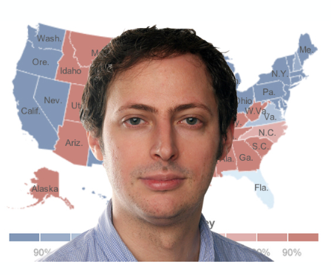
Introduction to Optimization
Nate Silver

Slide 14
Introduction to Optimization
Nate Silver
American Data Scientist who analyzes elections and baseball.
PECOTA: a system for forecasting the performance and career development of Major League Baseball players.
2008 U.S. Presidential election
  sucessfully called the outcome of 49 of the 50 states.

Slide 15
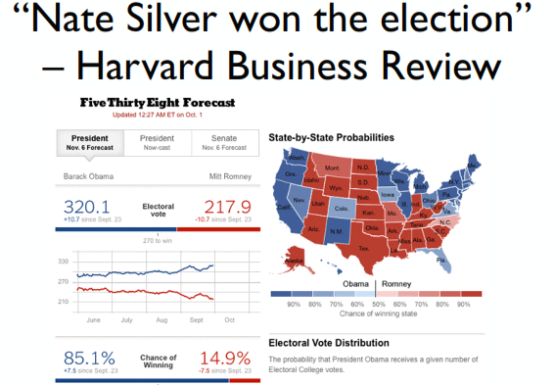
2012 U.S. Presidential election
  Correctly predicted the winners of all the states.

Slide 16
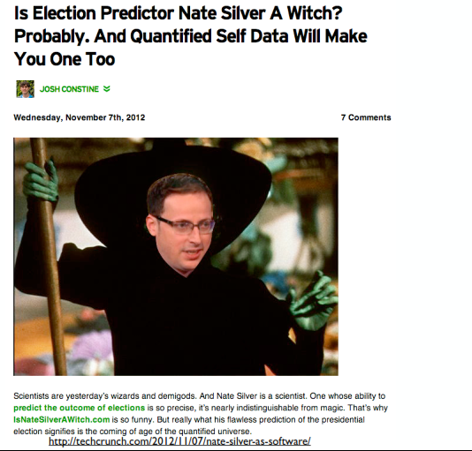
Introduction to Optimization

Slide 17
Introduction to Optimization
Some Key Principles
use many data sources
understand how the data were collected (sampling is essential)
weight the data thoughtfully (not all polls are equally good)
use statistical models (not just hacking around in Excel)
understand correlations (e.g., states that trend similarly)
have good communication skills (What does a 60% probability even mean? How can we visualize, validate, and understand the conclusions?)

Slide 18
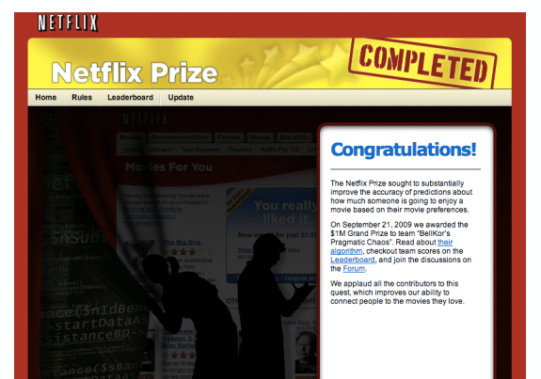
Introduction to Optimization
Netflix Prize

Slide 19
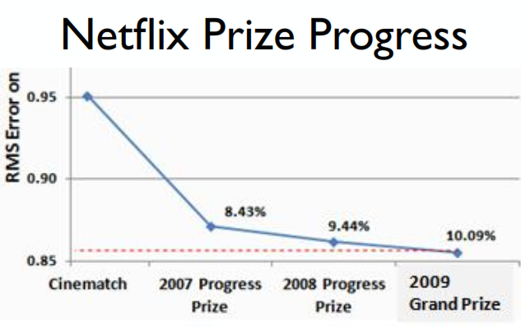
Introduction to Optimization
Netflix Prize

Slide 20
Introduction to Optimization
Netflix Prize

Slide 21
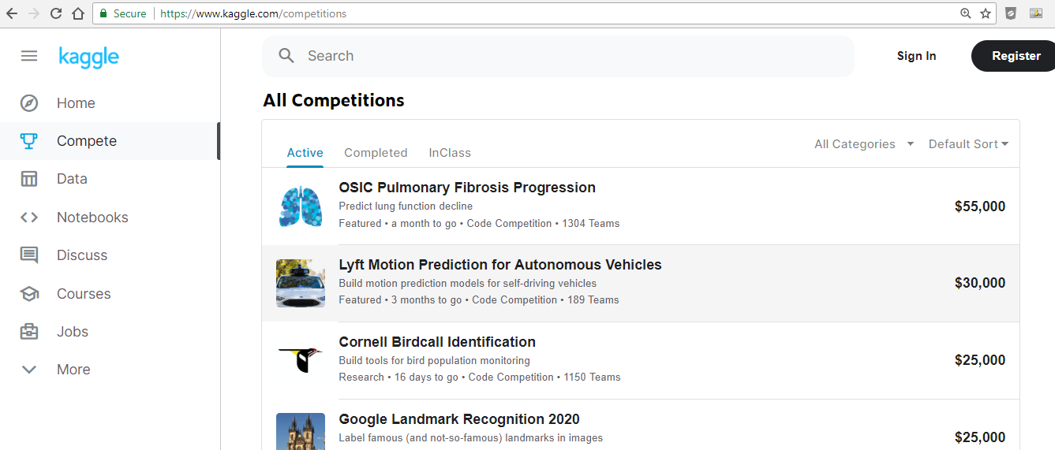
Introduction to Optimization
Kaggle

Slide 22
Introduction to Optimization
Why do we need Data Science?
Big Data
“Between the dawn of civilization and 2003, we only created ﬁve exabytes of information; now we’re creating that amount every two days.”
- Eric Schmidt, Google (and others)

Slide 23
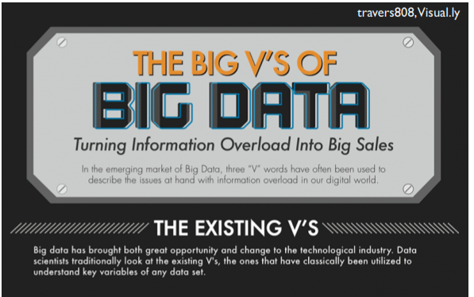
Introduction to Optimization
Why do we need Data Science?

Slide 24
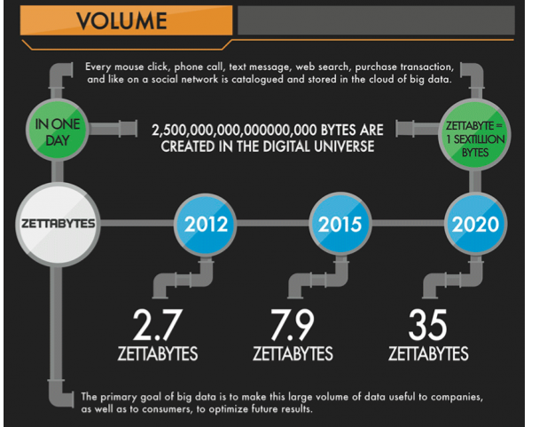
Introduction to Optimization
Why do we need Data Science?

Slide 25
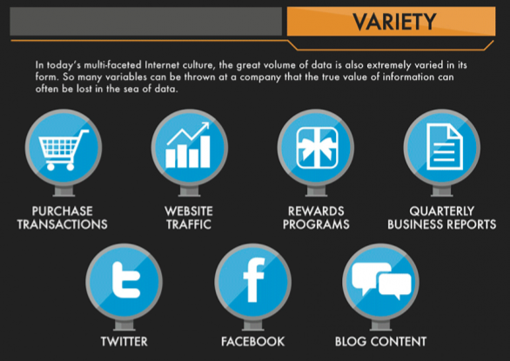
Introduction to Optimization
Why do we need Data Science?

Slide 26
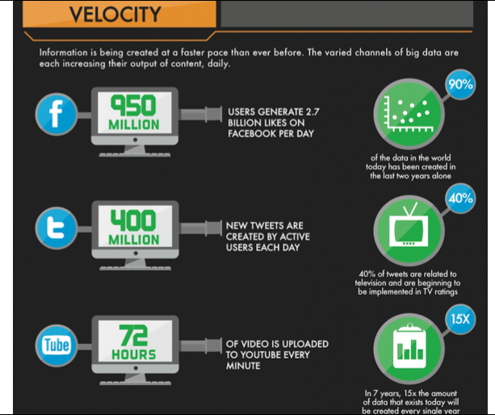
Introduction to Optimization
Why do we need Data Science?

Slide 27
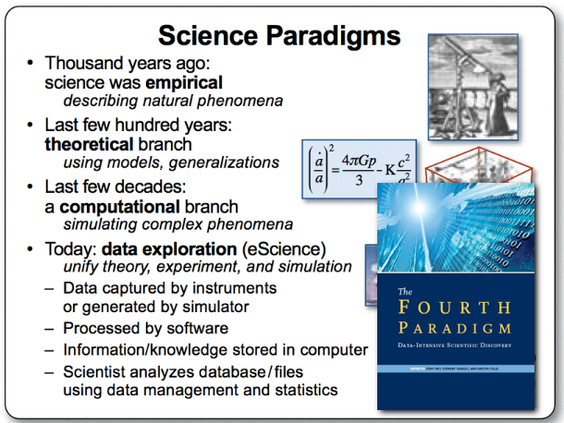
Introduction to Optimization
Science Paradigms
Jim Gray, Micrsoft

Slide 28
Introduction to Optimization
The best job in the next 10 years will be Data Scientist. (Not statistsians)
- Hal Varian, (Prof. UC Berkeley, Chief Economist, Google)

Slide 29
Introduction to Optimization
HalVarian says…
The ability to take data – to be able to understand it, to process it, to extract value from it, to visualize it, to communicate it's going to be a hugely important skill in the next decades, not only at the professional level but even at the educational level for elementary school kids, for high school kids, for college kids. Because now we really do have essentially free data.” – Hal Varian

Slide 30
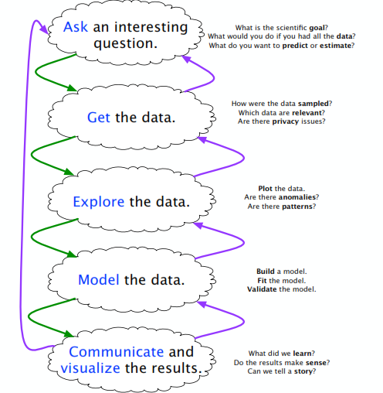
Introduction to Optimization
Data Science: Hanspeter Pfister

Slide 31
Introduction to Optimization
How?
data wrangling/scraping/sampling/cleaning in order to get an informative, manageable data set;
Other data preprocessing: Dimensionality reduction, feature subset selection, feature creation etc.
data storage and management in order to be able to access data quickly and reliably during subsequent analysis;
exploratory data analysis to generate hypotheses and intuition about the data;
prediction based on statistical tools such as regression, classiﬁcation, and clustering;
communication of results through visualization, and interpretable summaries.
Data Science: Hanspeter Pfister

Slide 32
Introduction to Optimization
Language and Tools
Language: Python
Tools: Jupyter Notebook, NumPy, Pandas
Other packages when needed: SciPy, matplotlib, scikit-learn, and SymPy
See IPython Tutorial: http://cs231n.github.io/ipython-tutorial/

